Slide 1
SOLID Principles

Slide 2
Object Oriented Programming
English Like Syntax
Organized Code and Data
Commonly Understood Designs (MVC, MVVM, etc…)
Reusable Code Blocks

Slide 3
SOLID Principles
S – Single Responsibility
Every class should have a single responsibility
O – Open Closed Principle
A class should be open for extensibility, but closed for modification
L – Liskov Substitution
Derived types must be completely substitutable for their base types
I – Interface Segregation
Clients should not be forced to depend on interfaces they do not use.
D – Dependency Inversion
High level modules should not depend on low-level modules. Both should depend on abstractions.

Slide 4
Code Smells
Key signs that something in your code could be redesigned in a more SOLID way.
Large methods / classes
A method takes up multiple screens
Difficulty understanding main purpose of code
Lots of infrastructure code
Difficulty in writing cohesive unit tests
Duplication of code (CTRL+C, CTRL+V)

Slide 5
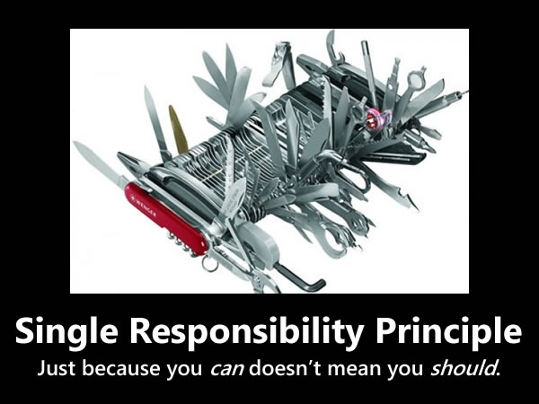
Single Responsibility Principle

Slide 6
Single Responsibility Principle
Intent
A class should have only one reason to change
Motivation
Every class should have a single responsibility, and that responsibility should be entirely encapsulated by the class.
Each class should do one thing, and do it well
Code Smells
Class has more than one reason to change
God classes / methods (a class that does everything)
Class / method names that include ‘and’ in them
Difficulty identifying single purpose for class
FYI
Single responsibility is simple in concept, but often hard to identify in code
Require a large number of unit tests to test a single function or class (Cyclomatic complexity)

Slide 7
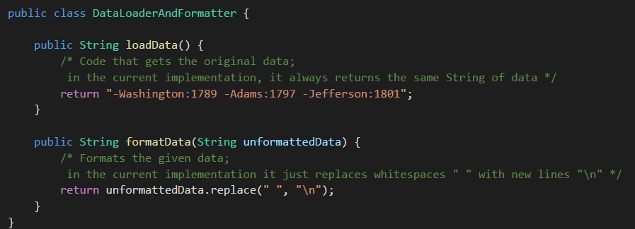
Single Responsibility Principle

Slide 8
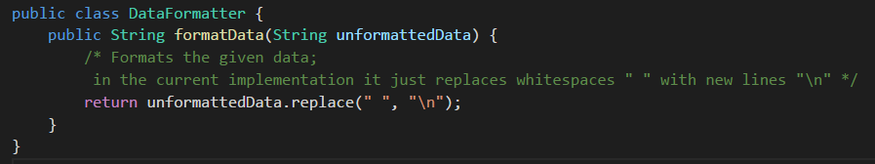
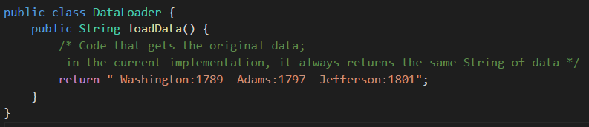
Single Responsibility Principle

Slide 9
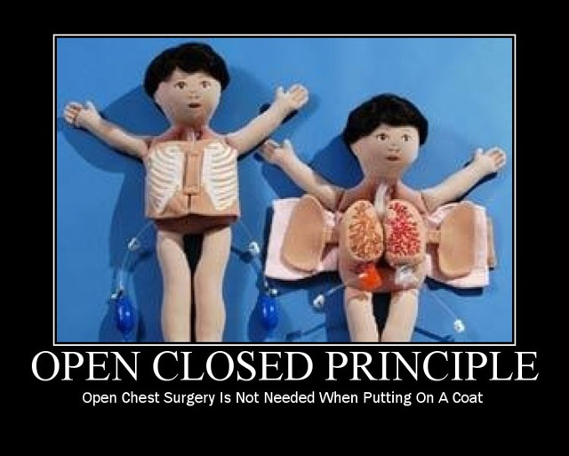
Open / Closed Principle

Slide 10
Open / Closed Principle
Intent
A class should be open for extensibility, but closed for modification
Motivation
New functionality should be added with minimum changes to existing code
Design should be done in way to allow adding new functionality as new classes instead of modifying existing classes
Changes to existing code can break existing logic (unit tests help but not always)
Code Smells
Adding new functionality requires modification to existing class
Changes to one class cascade to other classes

Slide 11
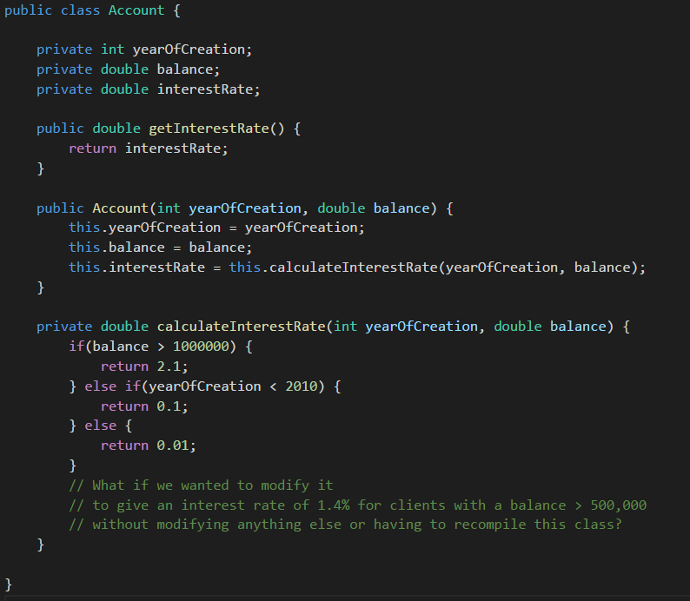
Open / Closed Principle
Example
InterestCalculator
InterestRuleOverMillion
InterestRuleTwentyTen
InterestRuleDefault

Slide 12
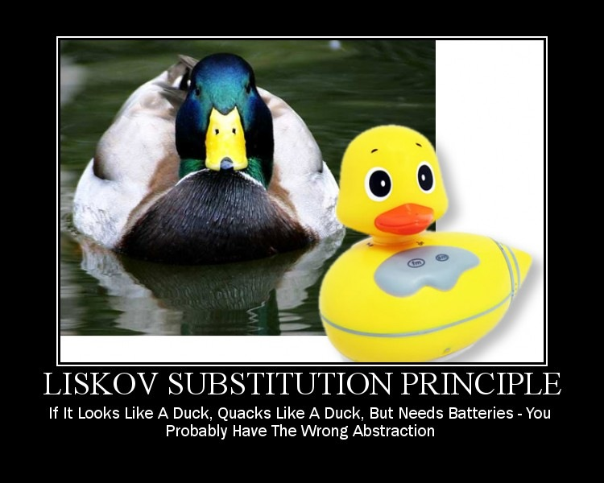
Liskov Substitution Principle

Slide 13
Liskov Substitution Principle
Intent
Derived types must be completely substitutable for their base types
Motivation
A new derived class should extend without replacing the functionality of the base class
Classes should be modeled based on behaviors not on properties
Code Smells
Methods exist in the base class that could be used to compromise the stability of functionality of the derived class
Methods exist in the base class that are no longer relevant in the derived class

Slide 14
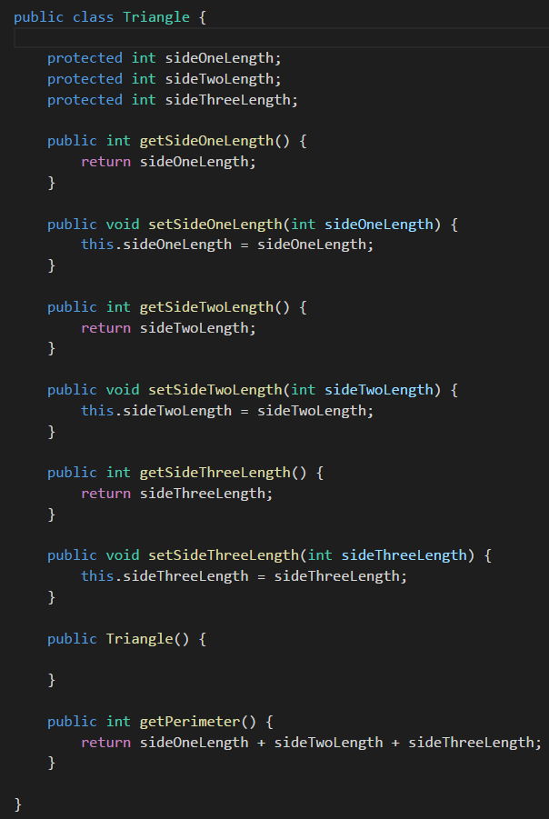
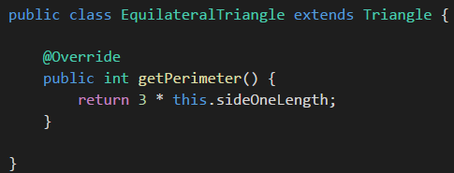
Liskov Substitution Principle

Slide 15
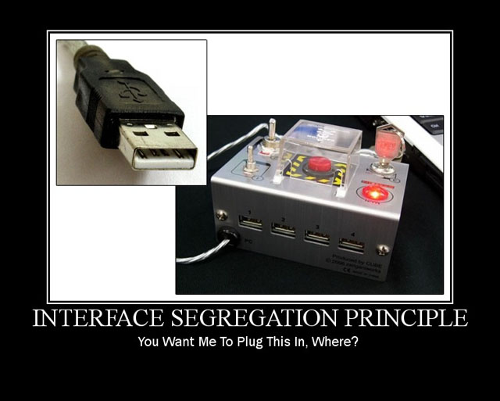
Interface Segregation Principle

Slide 16
Interface Segregation Principle
Intent
Clients should not be forced to depend on interfaces they do not use.
Motivation
Create thin specific interfaces over fat generic interfaces
A class that implements an interface should need to implement all methods of that interface
Code Smells
An interface does more than it should
An interface can be split up into multiple smaller interfaces
A class fakes out or does not implement one or more methods in an interface because those methods do not apply to that particular class.
Difficult or excessive set-up to write unit tests

Slide 17
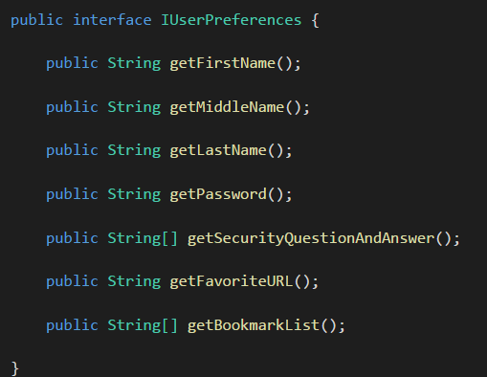
Interface Segregation Principle
IUserNameStore
IUserSecurityCredentialsStore
IUserFavoritesStore

Slide 18
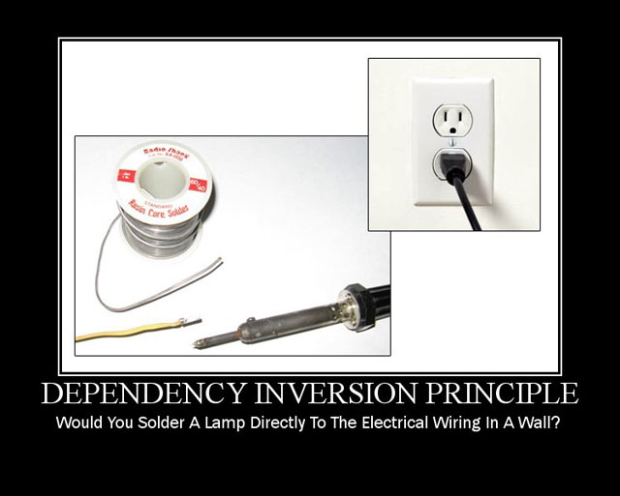
Dependency Inversion Principle

Slide 19
Dependency Inversion Principle
Intent
High level classes/modules should not depend on low-level classes/modules. Both should depend on abstractions.
Motivation
An abstraction layer between high level classes and low level classes makes the system more flexible and maintainable
High level modules to call low level modules through abstraction and vice-versa
Code Smells
High level classes depend heavily on low level classes
High level classes instantiate low level classes directly.
A high level class will need to be modified if a low level class is swapped
Unit tests require set up for classes other than the one I am testing
Unit tests are ‘impossible’ due to external dependencies

Slide 20
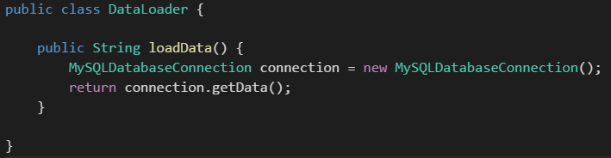
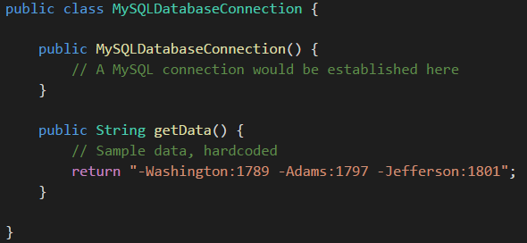
Dependency Inversion Principle
High Level Class
Low Level Class

Slide 21
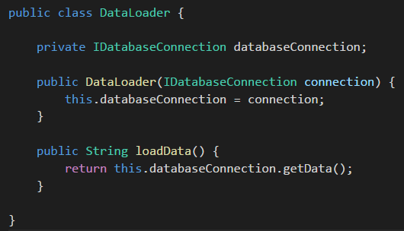
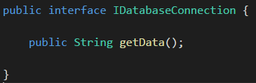
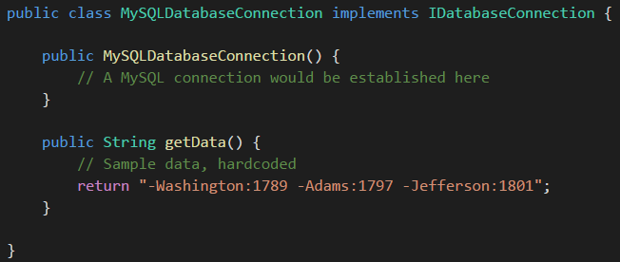
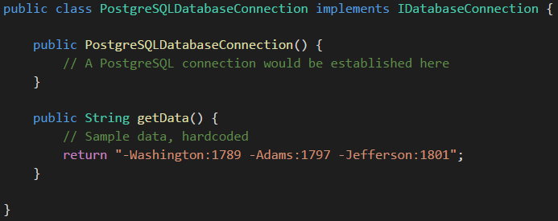
Dependency Inversion Principle
High Level Class
Abstraction Layer
Low Level Class

Slide 22
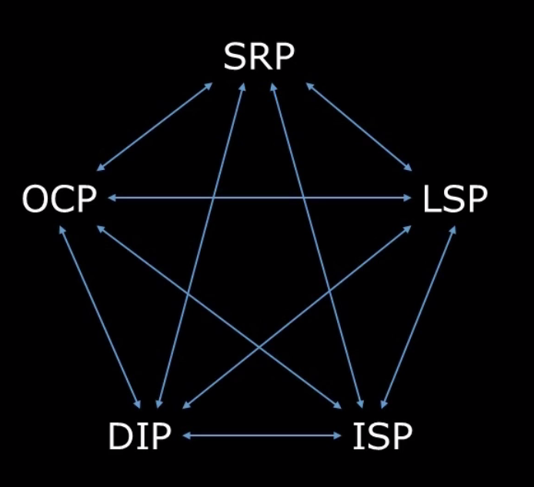
SOLID Relationships

Slide 23
Favor Composition over Inheritance
Most languages only support single inheritance
When you inherit from another class, you close off any options to inherit from any other source.
Makes derived class very inflexible
Use interfaces instead of inheritance

Slide 24

Demo / Questions

